Slide 1




About Us
Why X60?
About CrossFit
About Zone Diet
Schedule
Contact Us
HYDERABAD’S FIRSTOFFICIAL CROSSFIT CENTRE
Join now for a free 30 day membership!
Do It Now!

Slide 2



About Us
Why X60?
About CrossFit
About Zone Diet
Schedule
Contact Us
X60 is a lifestyle. A healthy lifestyle that involves
eating right, exercising regularly & sleeping well so you become fitter, healthier &
Stronger ...... Everyday.
Eat Right
Exercise Regularly
Sleep Well
i.e. meat/ vegetables, nuts & seeds, some fruits, little starch and no sugar.
Outsource the headache of measuring, preparing and monitoring your intake to levels that will support exercise but not body fat.
Make inactivity your enemy. Keep workouts short and intense for dramatic gains in fitness.
Spend 60 mins a day at our certified CrossFit centre for a high intensity, constantly varied functional workout. Certified trainers & peers will guarantee its competitive & fun
One less hour of sleep does not equal an extra hour of achievement or enjoyment. Rest longer today to get more done tomorrow.
Allow us to monitor your sleep patterns and share simple tips that will greatly enhance your quality of sleep.
Join now for a free 30 day membership!
Do It Now!

Slide 3
About Us
Why X60?
About CrossFit
About Zone Diet
Schedule
Contact Us
Comprehensive:
Only Certified CrossFit Centre in Hyderabad:
Healthy meals measured as per your intake levels:
Join now for a free 30 day membership!
Do It Now!

Slide 4

About Us
Why X60?
About CrossFit
About Zone Diet
Schedule
Contact Us
CrossFit is constantly varied functional movements performed at high intensity that lead to dramatic gains in fitness.
Overall, the aim of CrossFit is to forge a broad, general and inclusive fitness supported by measurable, observable and repeatable results. The program is designed for universal scalability, making it the perfect application for any committed individual, regardless of experience. To know more visit https://www.crossfit.com
All CrossFit workouts are based on functional movements that reflect the core movements of life.
Intensity is essential for results - the more work you do in less time, the more intense the effort.
The spontaneous community of people working out together makes it competitive and fun.
Accurate scores & records, timers and precisely defined workouts, ensure unprecedented output and high motivation.
Join now for a free 30 day membership!
Do It Now!

Slide 5

About Us
Why X60?
About CrossFit
About Zone Diet
Schedule
Contact Us
To learn more visit www.zonediet.com
The Zone Diet requires that you simply balance your plate at every meal and snack with these nutrients:
Protein – 1/3rd of your plate, add some lean protein, about the size and thickness of your palm. This could include egg whites, fish, poultry, lean beef or low-fat dairy.
Carbohydrates – 2/3rds of your plate, add a lot colorful vegetables and a little fruit. Fruits and vegetables to avoid are those that are high in sugar (e.g., bananas, carrots, grapes, raisins) or starchy (e.g., potatoes, corn).
Fat – Add a little bit of monounsaturated fat. This could include olive oil, avocado, or almonds.
Join now for a free 30 day membership!
Do It Now!

Slide 6
About Us
Why X60?
About CrossFit
About Zone Diet
Schedule
Contact Us
Monday | Tuesday | Wednesday | Thursday | Friday | Saturday | Sunday
6:00 AM | 6:00 AM | 6:00 AM | 6:00 AM | 6:00 AM | 6:00 AM | 6:00 AM
7:15 AM | 7:15 AM | 7:15 AM | 7:15 AM | 7:15 AM | 7:15 AM | 7:15 AM
8:30 AM | 8:30 AM | 8:30 AM | 8:30 AM | 8:30 AM | 8:30 AM | 8:30 AM
5:30 PM | 5:30 PM | 5:30 PM | 5:30 PM | 5:30 PM | 5:30 PM | 5:30 PM
6:45 PM | 6:45 PM | 6:45 PM | 6:45 PM | 6:45 PM | 6:45 PM | 6:45 PM
8:00 PM | 8:00 PM | 8:00 PM | 8:00 PM | 8:00 PM | 8:00 PM | 8:00 PM
Join now for a free 30 day membership!
Do It Now!

Slide 7
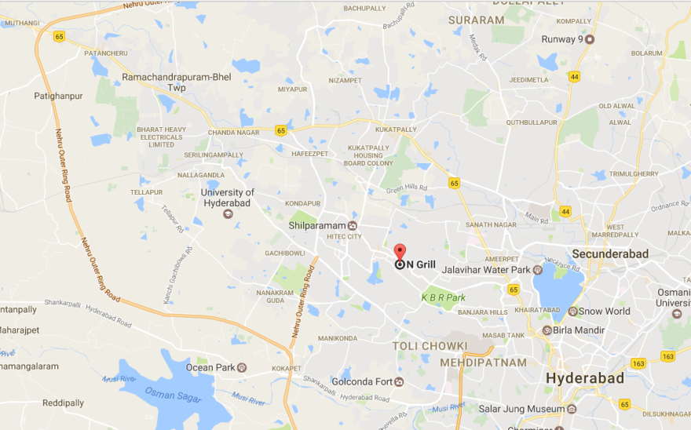


About Us
Why X60?
About CrossFit
About Zone Diet
Schedule
Contact Us
3rd Floor, 789 Landmark, Rd No. 36, Jubilee Hills
(Beside N Grill)
www.x60crossfit.in
Your Name:
Email ID:
Phone Number:
Subject:
Your Message:
+91 9963993266
x.rishi@gmail.com
Send
Join now for a free 30 day membership!
Do It Now!

